Slide 1
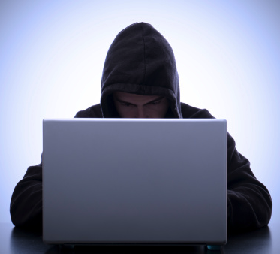
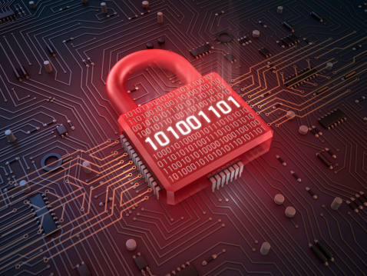
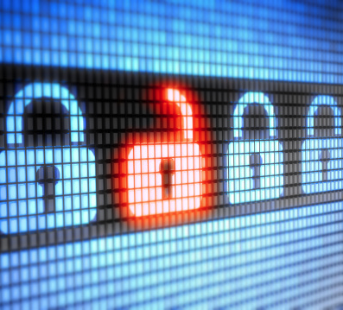

Introduction
INGI2347: COMPUTER SYSTEM SECURITY (Spring 2014)
Marco Canini
Lecture slides adapted from UCL INGI2347 by Gildas Avoine and Upenn CSE331 by Steve Zdancewic Reproduced with permission
Notes:
Image source: http://www.scmagazine.com/top-five-data-breaches-in-2013so-far/slideshow/1387/#

Slide 2
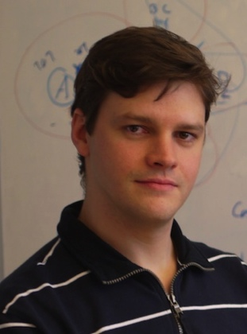
Welcome!
My name: Marco Canini
New faculty member at INGI
Supplying Gildas Avoine for this course
Research interests:
Software-Defined, Reliable Networked Systems
Cloud Computing
See also: http://perso.uclouvain.be/marco.canini/

Slide 3
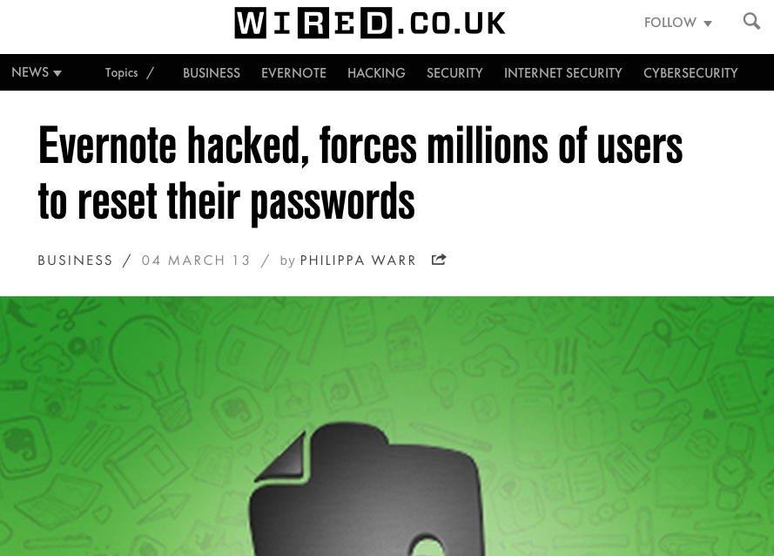
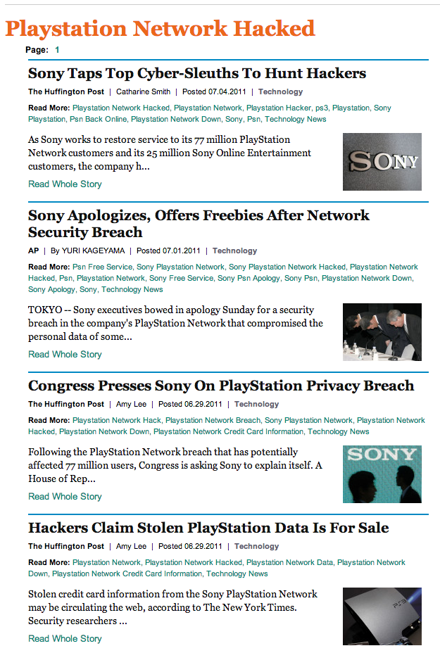
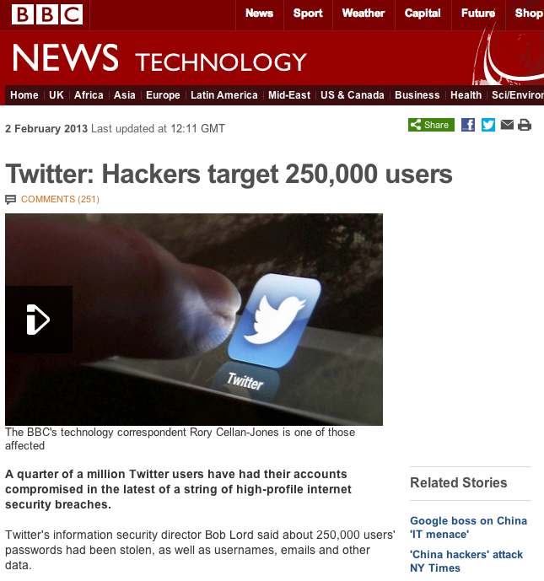
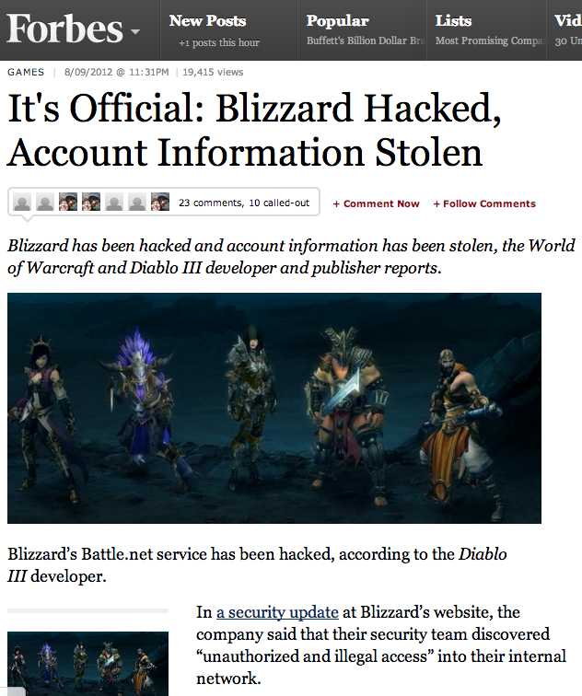
Let’s start
Every day news about new attacks and vulnerabilities
Check out www.cert.org for plenty of examples

Slide 4
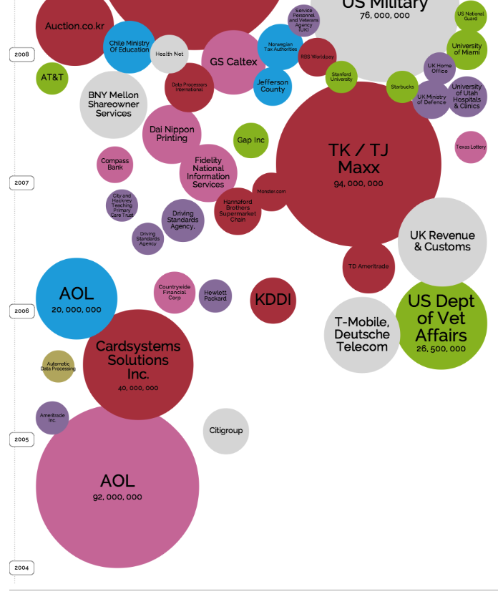

Exponential growth of security incidents over the past 25+ years
http://www.informationisbeautiful.net/visualizations/worlds-biggest-data-breaches-hacks/

Slide 5
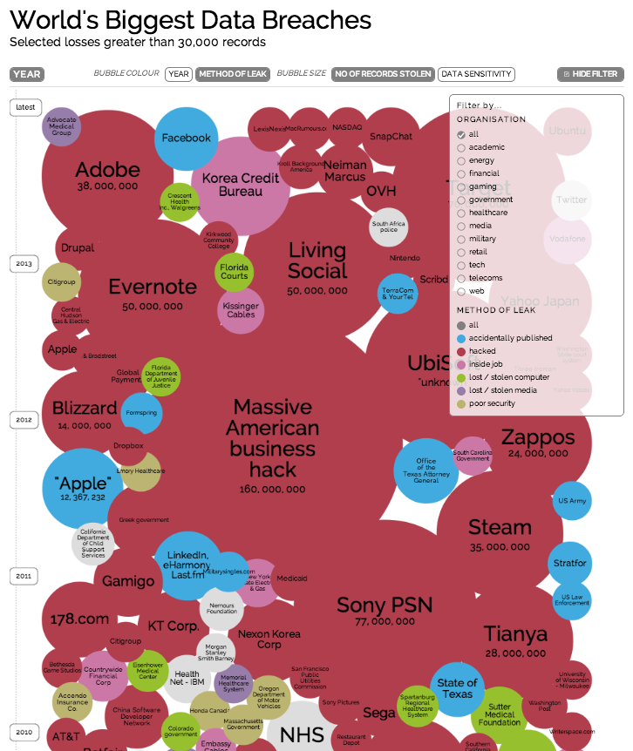
Exponential growth of security incidents over the past 25+ years
Networked systems are more and more complex
Difficult to protect them from ever more sophisticated attacks
http://www.informationisbeautiful.net/visualizations/worlds-biggest-data-breaches-hacks/

Slide 6
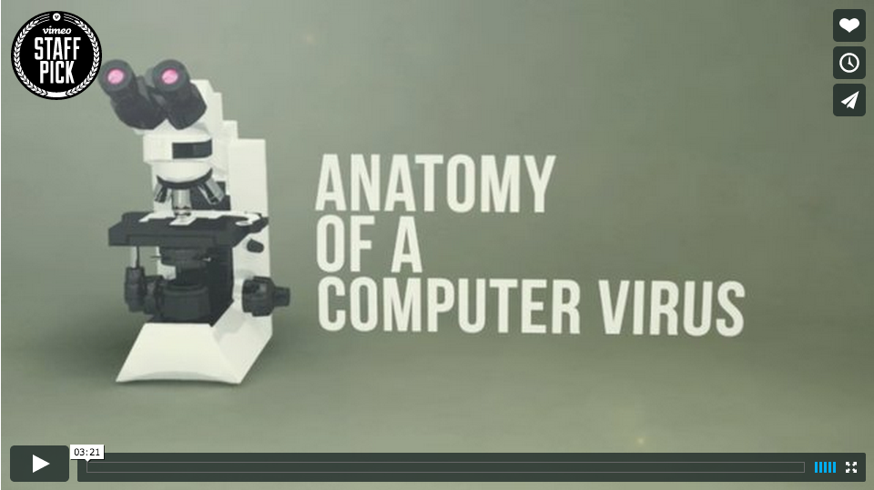
Stuxnet
Stuxnet: Anatomy of a Computer Virus (watch at https://vimeo.com/25118844)
Direction and Motion Graphics: Patrick Clair http://patrickclair.com
Written by: Scott Mitchell
Production Company: Zapruder's Other Films.

Slide 7
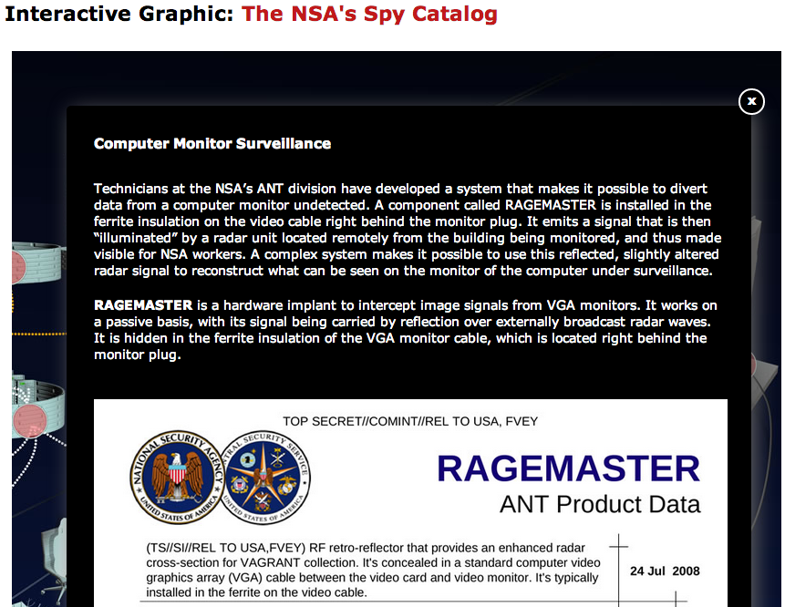
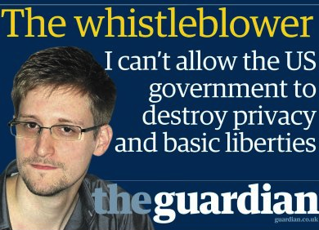
Recently heard about NSA?
Checkout “Jacob Applebaum: To protect And Infect, Part 2” http://youtu.be/vILAlhwUgIU
http://www.spiegel.de/international/world/a-941262.html

Slide 8
What is INGI2347 about?
Wide view of security
Mosaic of security problems and solutions
Objective
Provide basic concepts and principles for a wide spectrum of security problems
A base for future security specialists
General knowledge for non-specialists
More descriptive than analytical
Technical approach

Slide 9
Course Contents
Spam and Malware
Forged E-Mail
Network vulnerabilities
Firewalls
Proxies | IDS
Cryptography | Certificates
Passwords | Time-memory trade-off
WEP | WPA
IPSec | SSL/TLS
Kerberos | PGP
Cloud computing security
Guest lecture: security viewed by the Compute Crime Unit

Slide 10

Plan for today
Lecture 1
Introduction
Course logistics
What is security?
CSI Survey
Risk Analysis
NEXT

Slide 11
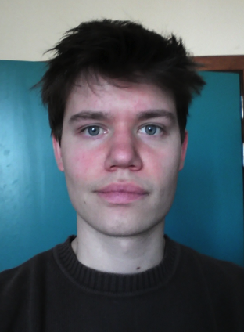
Course Staff
Marco Canini
Réaumur A-049, x7-4832
Xavier Carpent (TA)
Réaumur A-140, x7-9102

Slide 12
Schedule and Rooms
Mondays 14:00 to 16:00, BARB 11
Tuesdays 8:30 to 10:30, BARB 20
Check regularly the online calendar!

Slide 13
Language
This course – including all supports (lectures, exercises, exam) – is in English
French if necessary
If you plan to give your answers in French, contact the course staff by end of Feb

Slide 14
Prerequisites
A priori Master 1st or 2nd Year
Would like to learn basic security principles
Background knowledge in computer networks
(e.g., INGI2141 or ELEC2920)
SMTP, Telnet, IP, TCP, UDP, ARP, MAC, OSI layered model
Reference: “Computer Networks” by Andrew Tanenbaum
Basic programming skills
(FSAB1401 or equiv.)
Familiarity with Java or C/C++, Python, bash scripting…

Slide 15
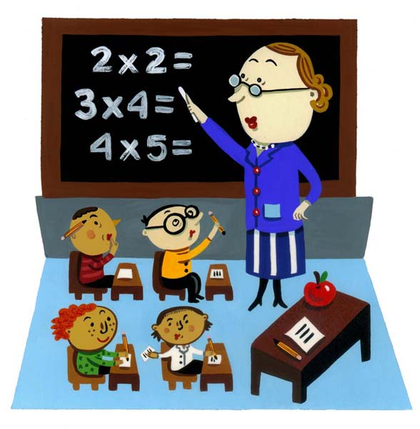
Teaching Activities
Lectures
No lecture notes but reference book
Exercises (classroom or computer room)
Challenges (taken into account for grading)
http://peerprograms.ubc.ca/2011/01/12/what-i-learned-in-class-today/

Slide 16
Lectures
Be on time!
If you come, this means you studied the previous lecture
Notes:
http://remibrossard.files.wordpress.com/2011/09/pendu11.gif

Slide 17
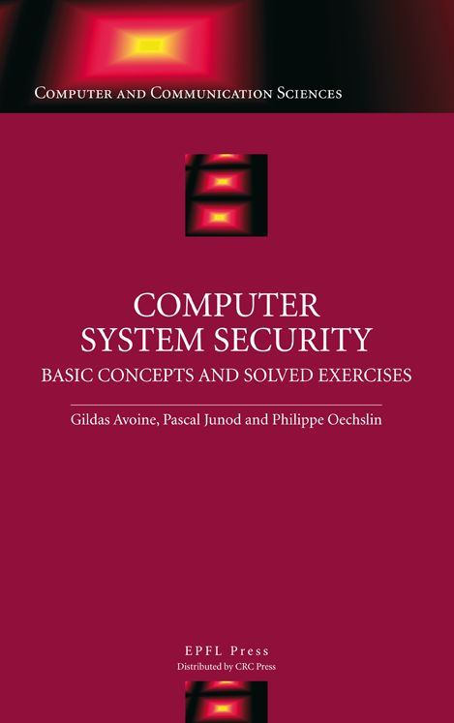
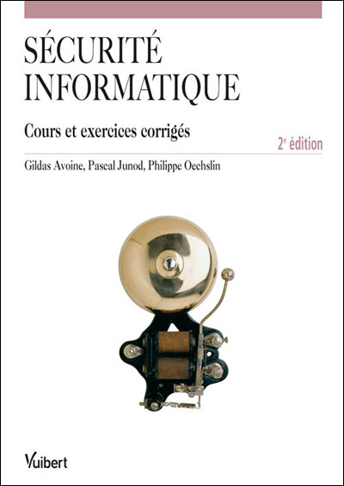
Textbook
“Computer System Security, Basic Concepts and Solved Exercises”, Avoine, Junod, and Oechslin, 270 pages, EPFL Press & CRC Press, English, 978-1420046209, 2007
Book is not mandatory
Available in the library or at the bookstore Agora
2nd version 2010 in French available
INGI2347 covers chapters 1 to 7

Slide 18
In-class Exercises
Exercise and solution sheets provided (printed)
Do not distribute (copyrighted)

Slide 19
Challenges
Practical exercises to be done «at home»
Challenge on TMTO evaluated in INTEL room
Challenges announced during the lectures or the exercises, solved during the exercises
1 to 4 weeks to solve each challenge
3 challenges over this term; all mandatory
Each challenge gives 2 pts
No collaboration on individual homework
(remember when posting messages on Piazza)

Slide 20
Challenges (2013/14)
Number | Points | Announced | Deadline | Content
Challenge 1 | 2 | 4 Feb | 24 Feb (23:59) | Web Security
Challenge 2 | 2 | 18 Mar | 3 Apr (23:59) | Password Cracking
Challenge 3 | 2 | 18 Mar | 23 Apr (23:59) | Time-memory Trade-off

Slide 21
June Examination
Challenges (6 pts)
The 3 challenges are considered
Written examination (14 pts)
3 hours, closed book

Slide 22
September Examination
Challenges (6pts)
The 3 challenges are considered
Oral examination (14 pts)
Closed book
Preparation (40’), presentation (20’)
If the challenges decrease the grade, then the oral examination only is considered
Grade = max(grade oral examination, grade oral examination * 14/20 + grade challenges)

Slide 23
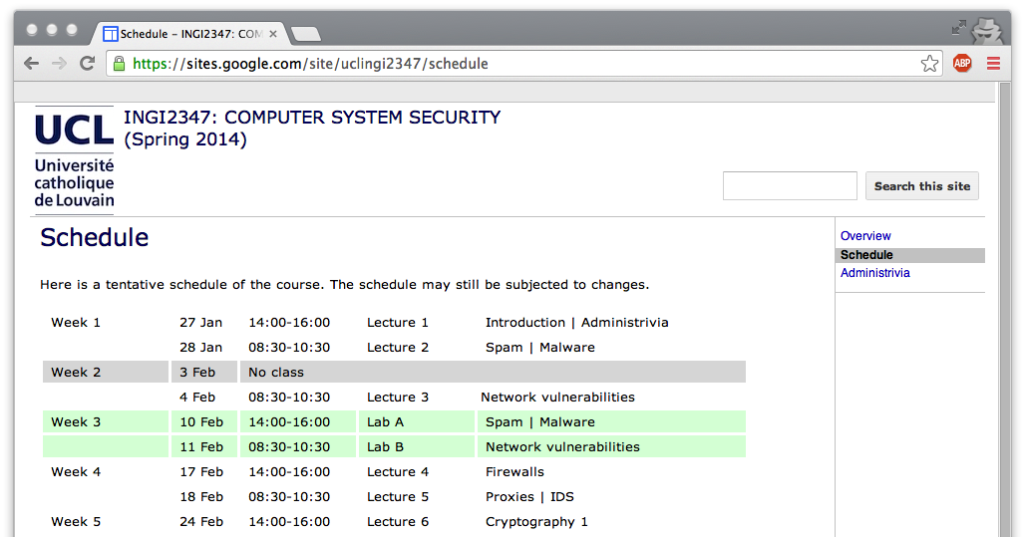
Course website
https://sites.google.com/site/uclingi2347/
Course schedule
Slides will be available on the web site
Linked to from the course schedule page

Slide 24

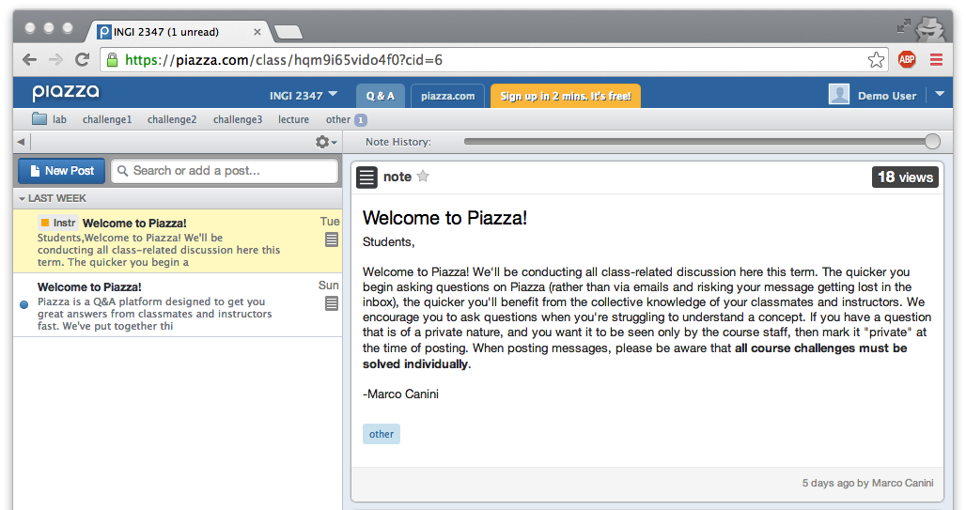
Course discussion group
We will be using for discussions related to this course
The TA and I will read the posts and respond to questions
Recall: no collaboration on challenges
Consider posting as private message to course staff only
Piazza will also be used for
Announce Challenges
Corrections/clarifications
Got the invite?
If not, enroll officially
Please sign up at https://piazza.com/uclouvain.be/spring2014/ingi2347
TODO

Slide 25
Ethics
This is a course on computer and network system security. Although the course is primarily concerned with techniques that are designed to ensure security of such systems, a proper understanding of those systems requires that you be versed in their vulnerabilities and failings as well. Nevertheless, unless you have explicit written authorization from the owner and operators of a computer network or system, you should never attempt to penetrate that system or adversely affect that system's operation. Such actions are a violation of the law and UCL's policy.
You are required to read and understand UCL's rules available at http://www.uclouvain.be/22811.html
If you would not be able to read or understand these rules, you must contact the teaching assistant or the lecturer

Slide 26
Supplementary reading (not mandatory)
Security Engineering by Ross Anderson
Freely available online: http://www.cl.cam.ac.uk/~rja14/book.html
Building Secure Software: How to Avoid Security Problems the Right Way by John Viega and Gary McGraw
The Protection of Information in Computer Systems by Saltzer and Schroeder, 1975

Slide 27
What do we mean by security?

Slide 28
What do we mean by security?
Information security is larger than computer security
Defending information from unauthorized access, use, disclosure, disruption, modification, perusal, inspection, recording or destruction [Wikipedia]
What does it mean for a computer system to be secure?

Slide 29
What do we mean by security?
What does it mean for a computer system to be secure?
The system only does what it is expected to
Should prevent unathorized use
What is “unathorized”?
What about spam?

Slide 30
When is a computer system secure?
When it does exactly what it should?
Not more
Not less
But how do we know what a system is supposed to do?
Somebody tells us?
But do we trust them?
We write the specification ourselves?
How do we verify that the software meets the specification?
We write the code ourselves?
But what fraction of the software you use have you written?
Can you trust the hardware it runs on?

Slide 31
When is a computer system secure?
2nd try: A program is secure when it doesn’t do something it shouldn’t
Easier to specify a list of “bad” things:
Delete or corrupt important files
Crash my system
Send my password or credit card details over the Internet
But... what if most of the time the program doesn’t do bad things, but occasionally it does? Is it secure?
Difficult to verify that a system does what it is expected to, impossible to verify that it does not what it is not expected to

Slide 32
“Security is mostly a superstition […]” – Helen Keller (1880-1968), American writer and activist
Security is all about trade-offs
Performance
Cost
Usability
Functionality
The right question is: how do you know when something is secure enough?
Still a hard question
Requires understanding of the trade-offs involved

Slide 33
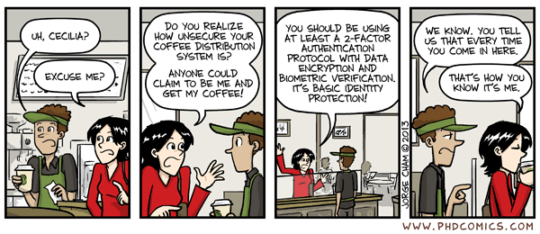
How to think about trade-offs?
What are you trying to protect? How valuable is it?
Nuclear missile launch station vs. … coffee machine
In what way is it valuable?
May be important only to one person (e.g. private e-mail or passwords)
May be important because accurate and reliable (e.g. bank’s accounting logs)
May be important because of a service it provides (e.g. Google’s web servers)

Slide 34
Classic CIA triad
Confidentiality
Unathorized disclosure of information
E.g. a credit card transaction system attempts to enforce confidentiality by encrypting credit card details over the Internet and in the transaction processing network
Integrity
Unathorized information modification
E.g. traditional Unix file permissions can be an important factor in single system measures for protecting data integrity
Availability
Unathorized denial of use
High availability systems aim to remain available at all times, preventing disruptions due to power outages, upgrades, hardware failures, Denial of Service (DoS) attacks, …

Slide 35
Example security techniques
Verifying the identity of a prospective user by demanding a password
Authentication
Shielding the computer to prevent interception and subsequent interpretation of electromagnetic radiation
Covert channels
Enciphering information sent communication channels
Cryptography
Locking the room containing the computer
Physical aspects of security
Controlling who is allowed to make changes to a computer system
Social aspects of security

Slide 36
Security goals
Prevent common vulnerabilities from occurring (e.g. buffer overflows)
Recover from attacks
Traceability, accountability and auditing of security-relevant actions
Monitoring
Detect attacks
Privacy, confidentiality, anonymity – Protect secrets
Authenticity
Needed for access control, authorization, etc.
Integrity
Prevent unwanted modification or tampering
Availability and reliability
Reduce risk of DoS

Slide 37
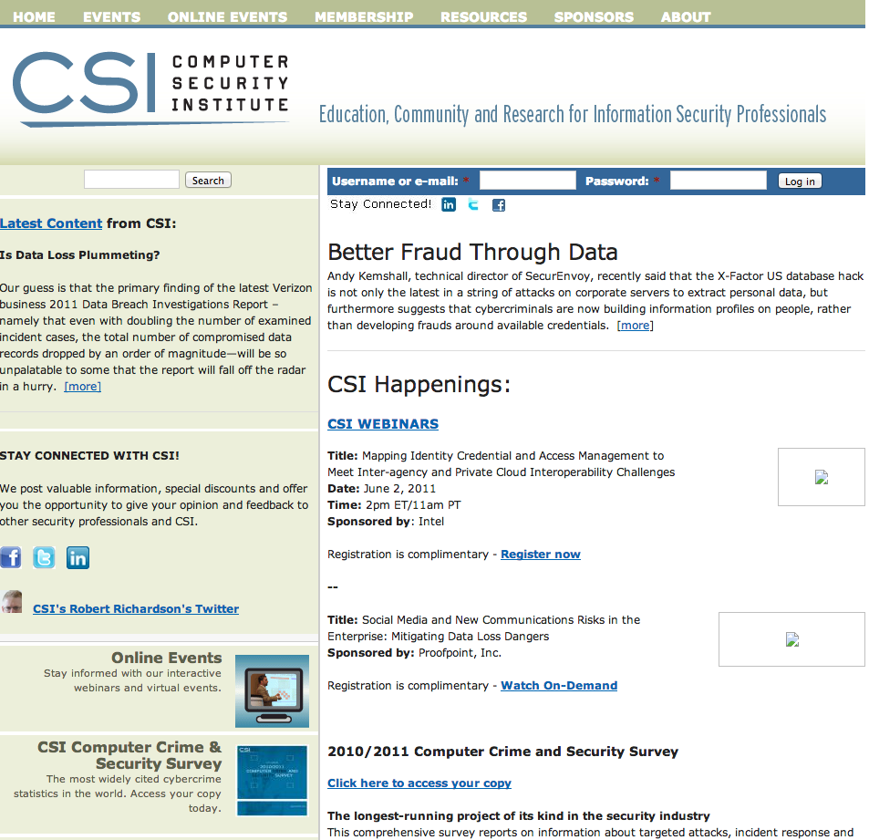
CSI Survey
“For the 13th year, CSI has asked its community how they were affected by network and computer crime in the prior year and what steps they’ve taken to secure their organizations”
Checkout http://www.gocsi.com/

Slide 38
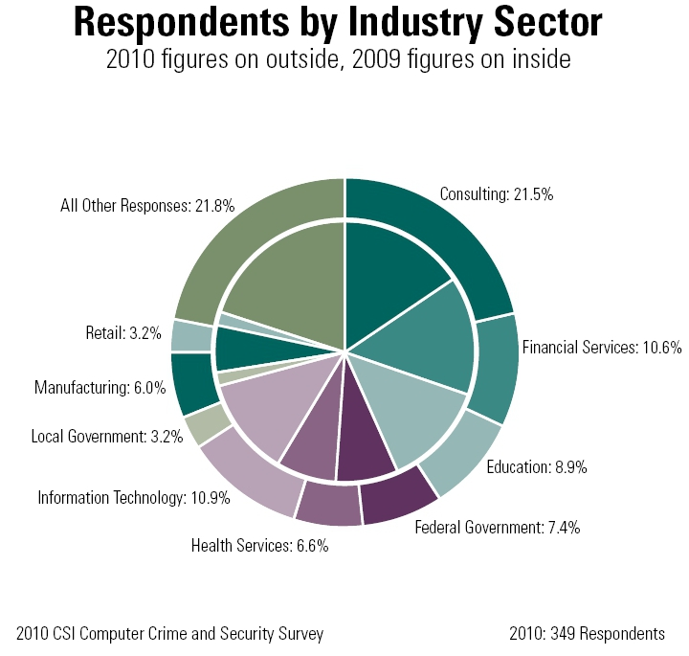
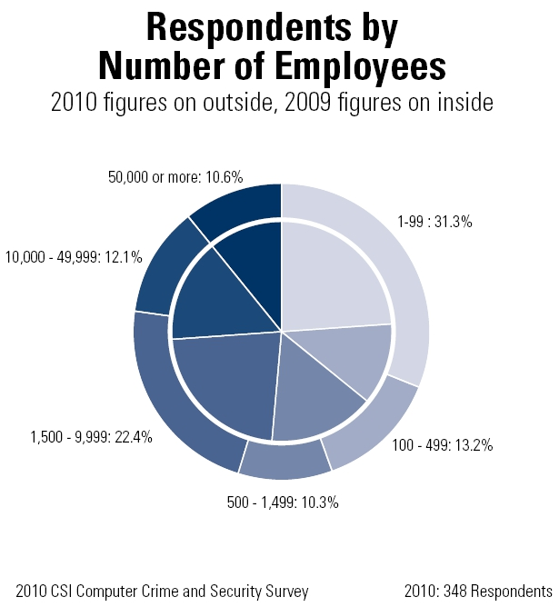
Statistics: Respondents’ Profile

Slide 39
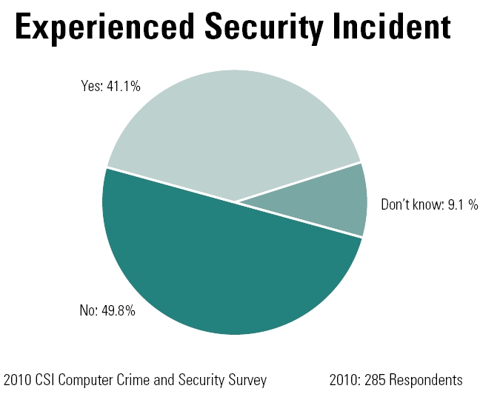
Statistics: Security Incidents
Notes:
The number of companies who declare that they suffered from a security incident slightly decreases. Previous years, it was roughly 45%/45%.

Slide 40
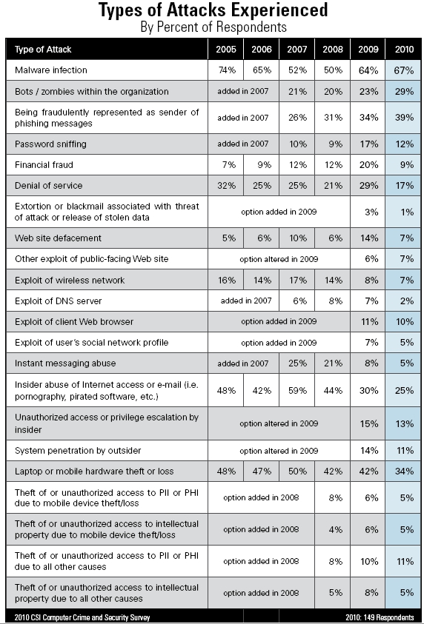
Statistics: Types of Attacks

Slide 41
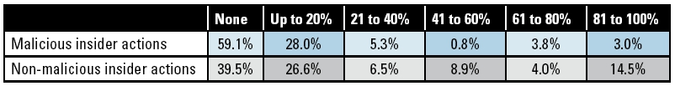
Statistics: Insiders
What percentage of monetary losses were attributable to actions or errors by individuals within the organization?

Slide 42
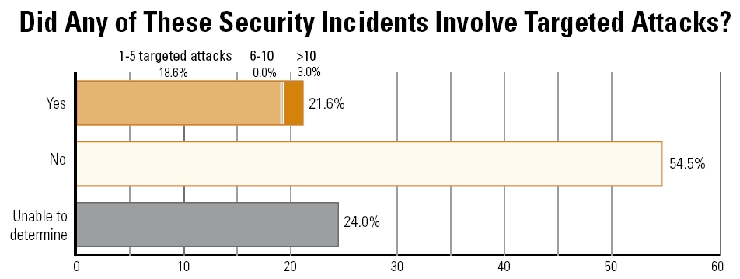
Statistics: Targeted Attacks

Slide 43
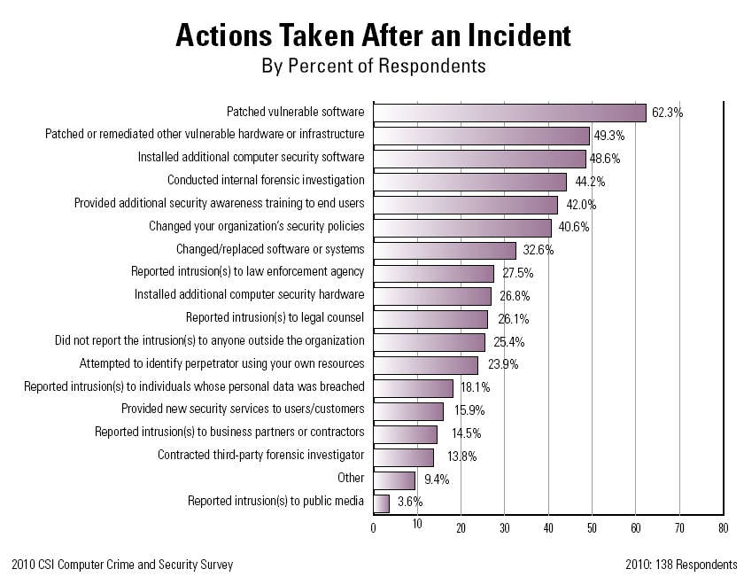
Statistics: After an Incident

Slide 44
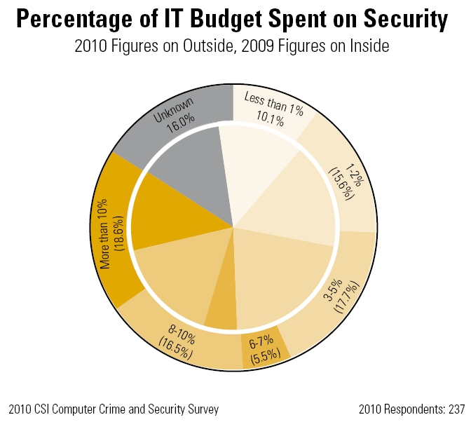
Statistics: IT Budget

Slide 45
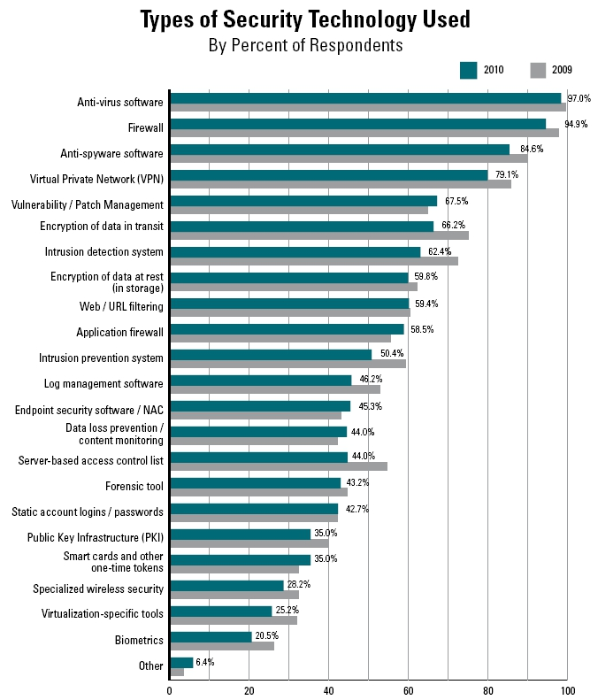
Statistics: Types of Security Techno- logy Used

Slide 46
Risk Analysis

Slide 47
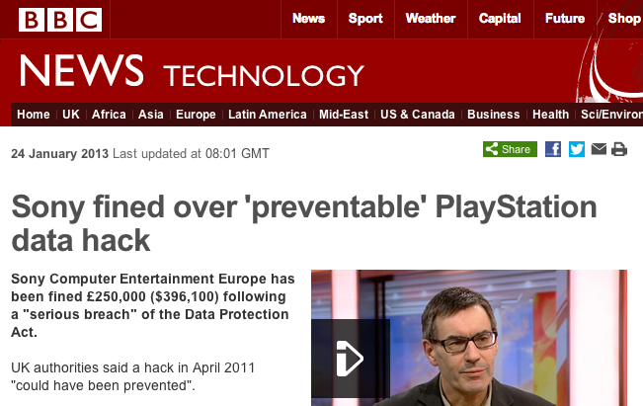
Security Incident: A Real Issue
Issues are real and have significant consequences
Direct financial losses
Indirect losses
Image of the company
Spying activities
Manage security in a general and systematic manner

Slide 48
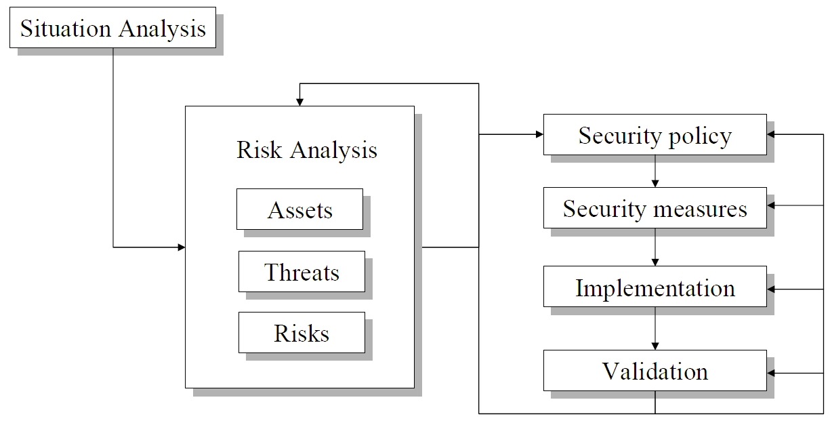
A Systematic Approach
Identify:
What needs to be protected?
From whom?
For how long?
How much is the protection worth?
Refine specifications:
More detailed the better
e.g. “Use crypto where appropriate.” vs. “Credit card numbers should be encrypted when sent over the network.”
How urgent are the risks?

Slide 49
Risk Analysis
Importance of assets (V)
Potential threats (M)
Evaluate probability of threat (P)
We must reach a reasonable residual risk
If interested, checkout Ch. 8 of the textbook to find more details, which are not covered in this course
Risk = ∑ P(M_{i}) V_{i}

Slide 50
Qualitative vs. Quantitative
Quantitative evaluation
Example:
Prob. to get a virus=10%
Cost to restore system=$1000
Risk is $100
Qualitative evaluation
 | Importance of impact
Prob. of occur. | Low | Medium | High
High | Low | Medium | High
Medium | Low | Medium | Medium
Low | Low | Low | Low

Slide 51
Any questions?

Slide 52
Tips
https://BetterCrypto.org
This project aims at creating a simple, copy & paste-able HOWTO for secure crypto settings of the most common services (webservers, mail, ssh, etc.)
https://www.howsmyssl.com/
A website that tells you how secure your TLS client is
Follow good software engineering principles, but take into account malicious behavior
Thirteen principles to ensure enterprise system security
http://searchsecurity.techtarget.com/opinion/Thirteen-principles-to-ensure-enterprise-system-security
Use community resources (CERT, BugTraq, etc.)

Slide 53
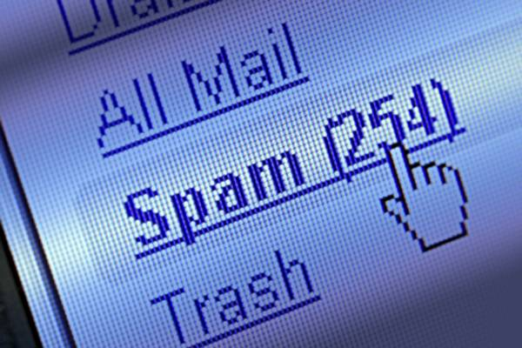
Spam | Malware
Stay tuned
Next time you will learn about

